Slide 1
Outreach – Junior Biocurator Program
Paul Sereno, Nizar Ibrahim, Paula Mabee
University of Chicago, University of South Dakota, Project Exploration

Slide 2
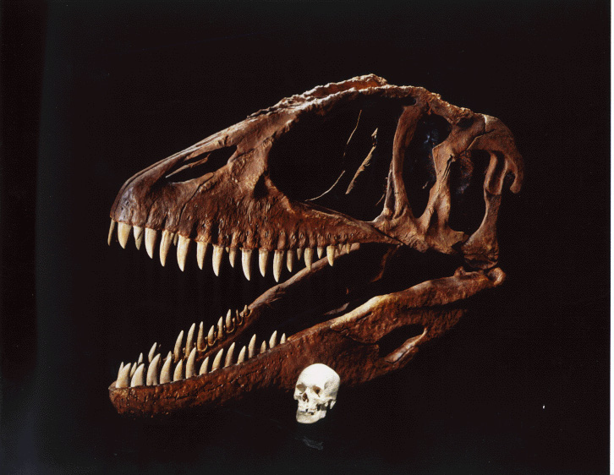

Slide 3
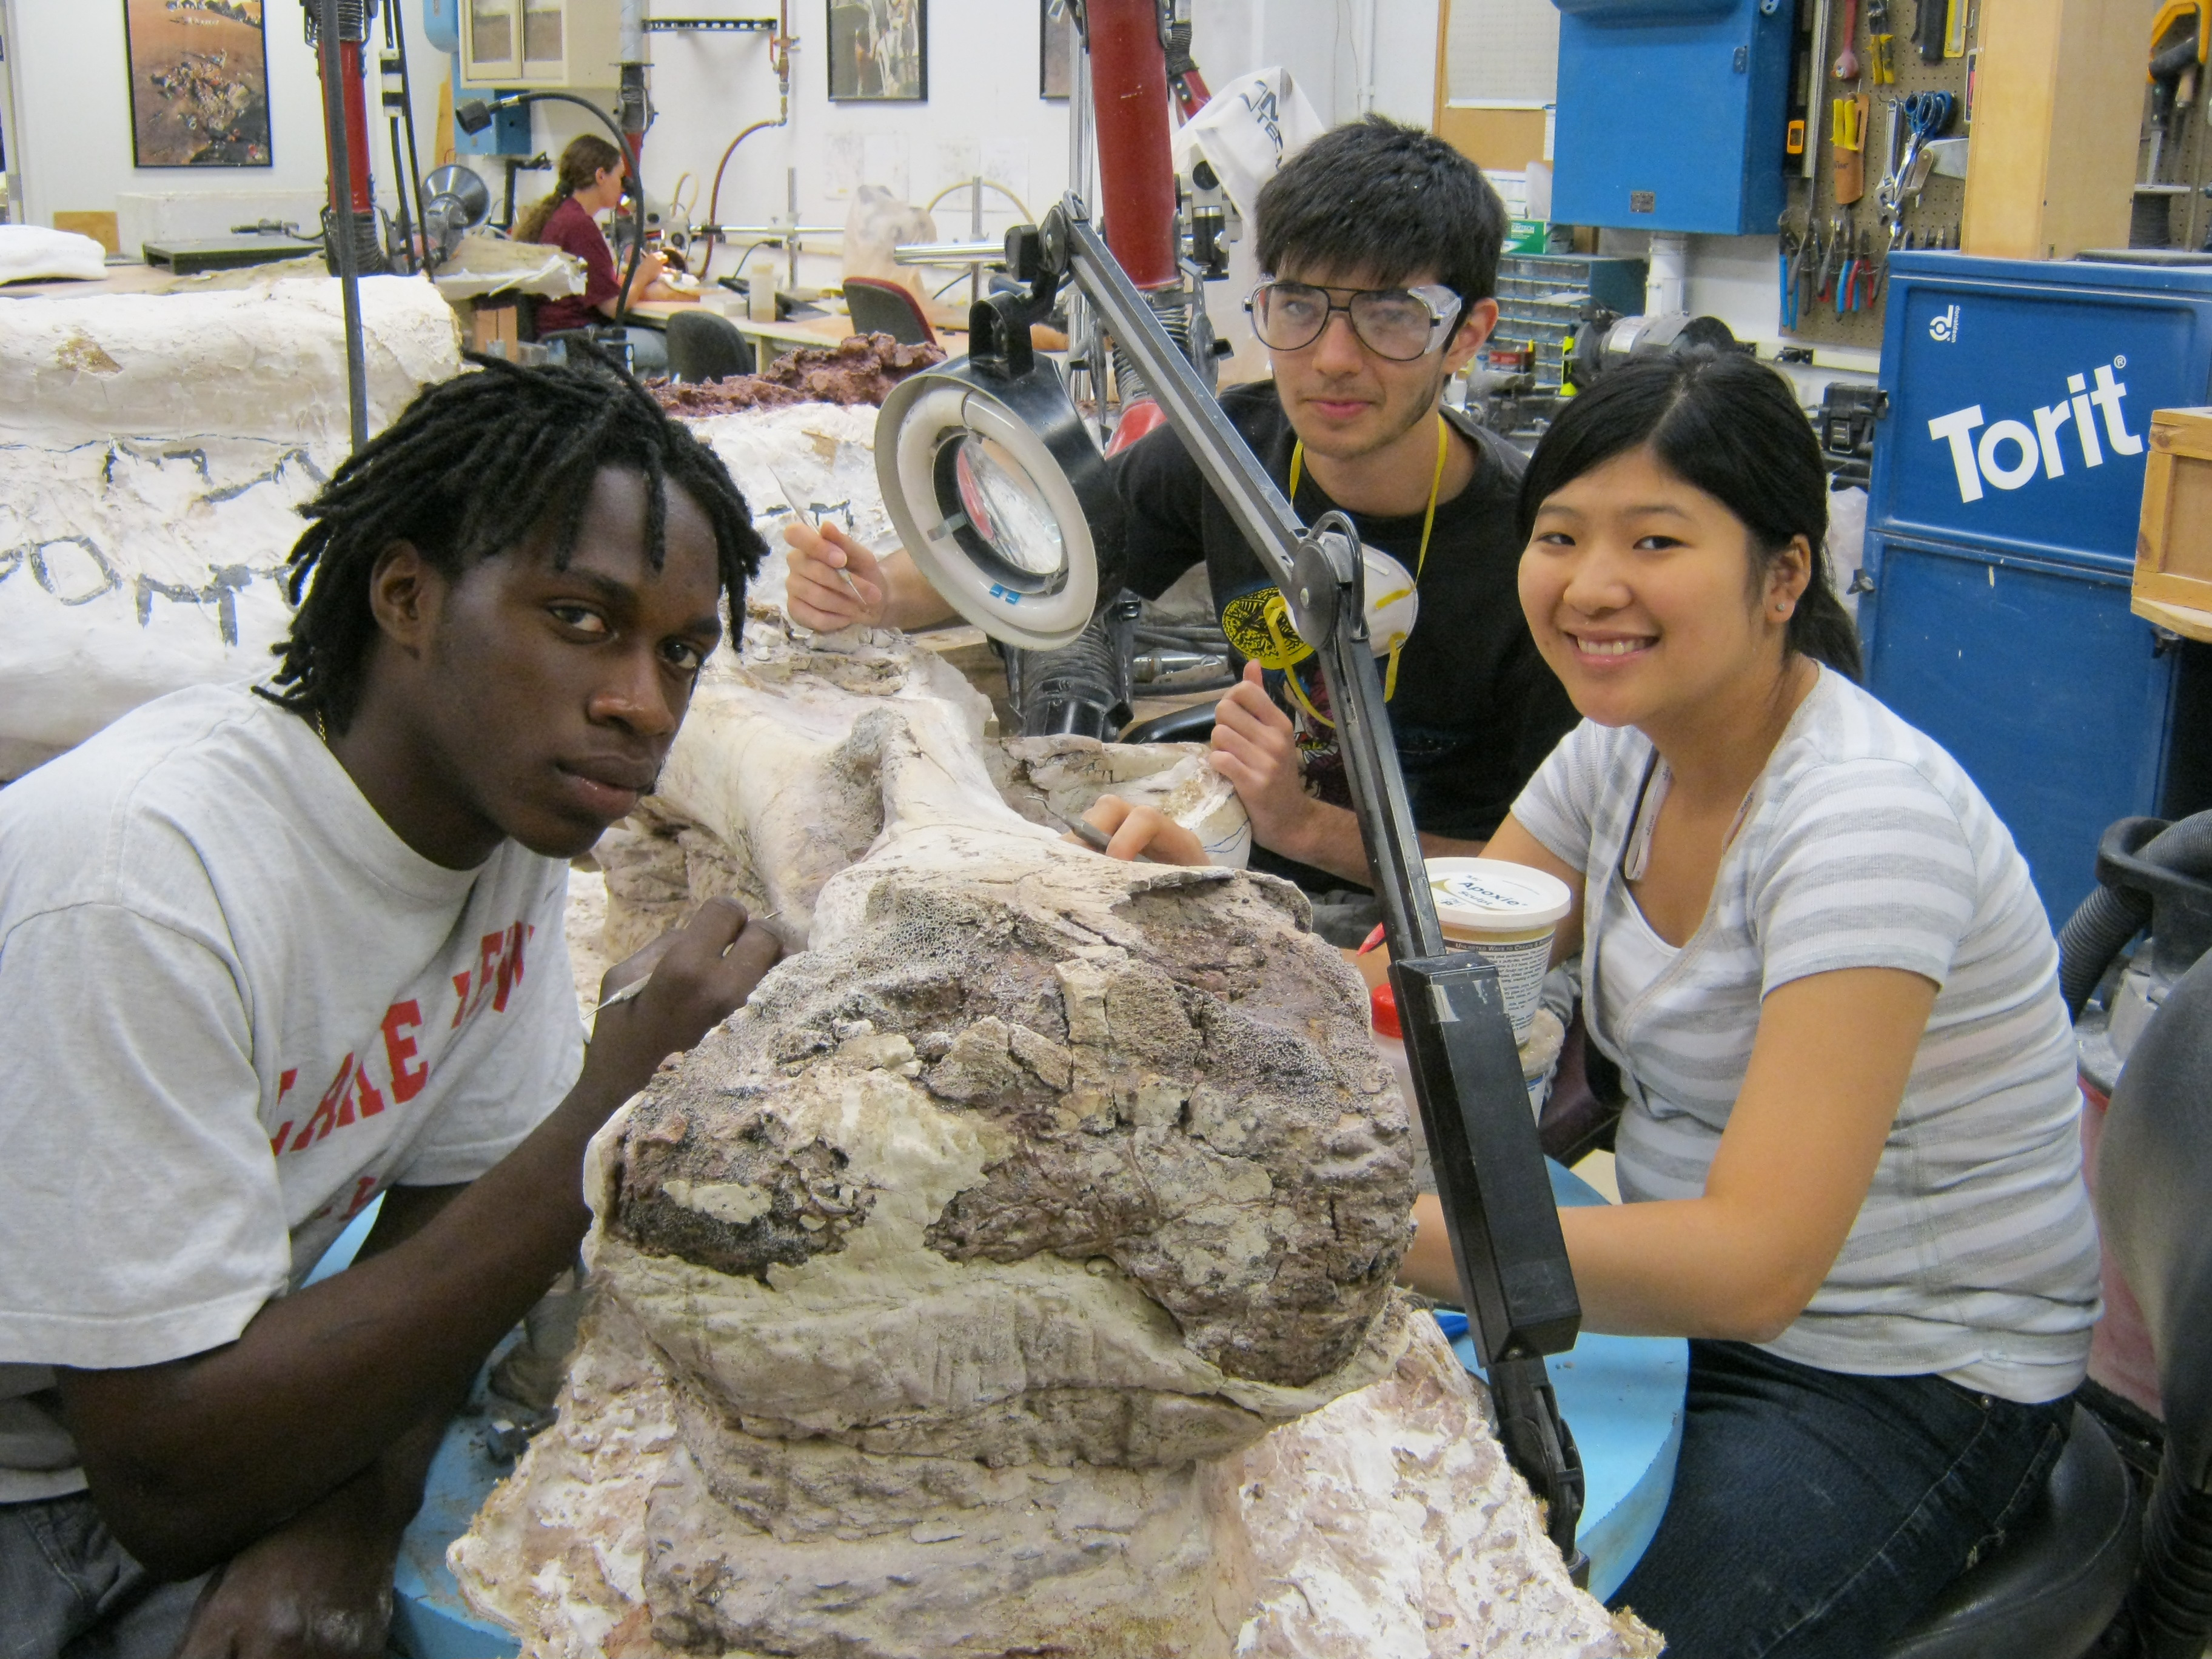

Slide 4
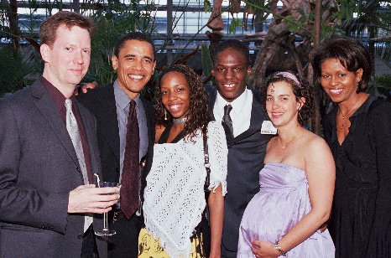

Slide 5
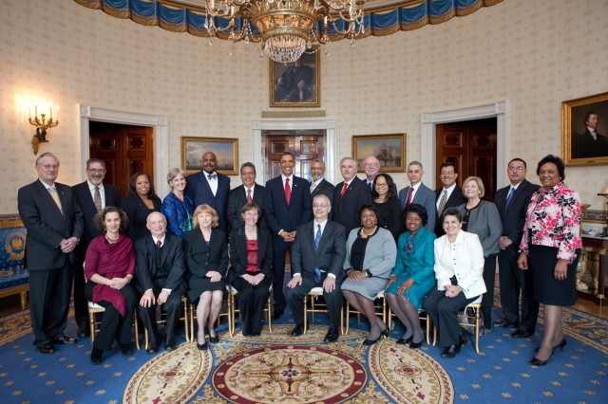
Presidential Award for Excellence in Science,
Mathematics and Engineering Mentoring (2009)

Slide 6
5 Jr Biocurators – 6 week program at the University of Chicago,
in collaboration with Project Exploration
Phase 1: Introduction to Morphological Biocuration – 2 weeks
Phase 2: Biocuration Imaging (Photography) – 3 weeks
Phase 3: Biocuration Imaging (Scanning) – 1 week

Slide 7
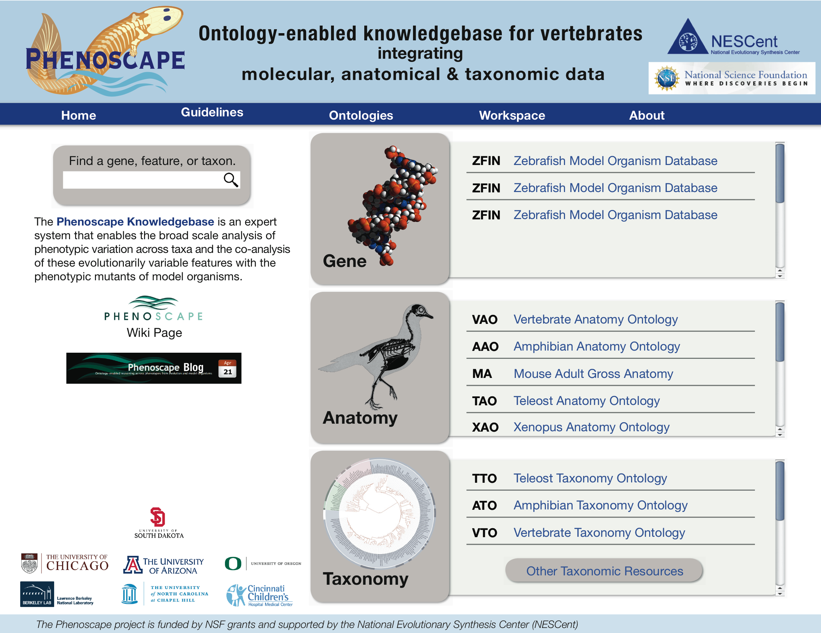

Slide 8
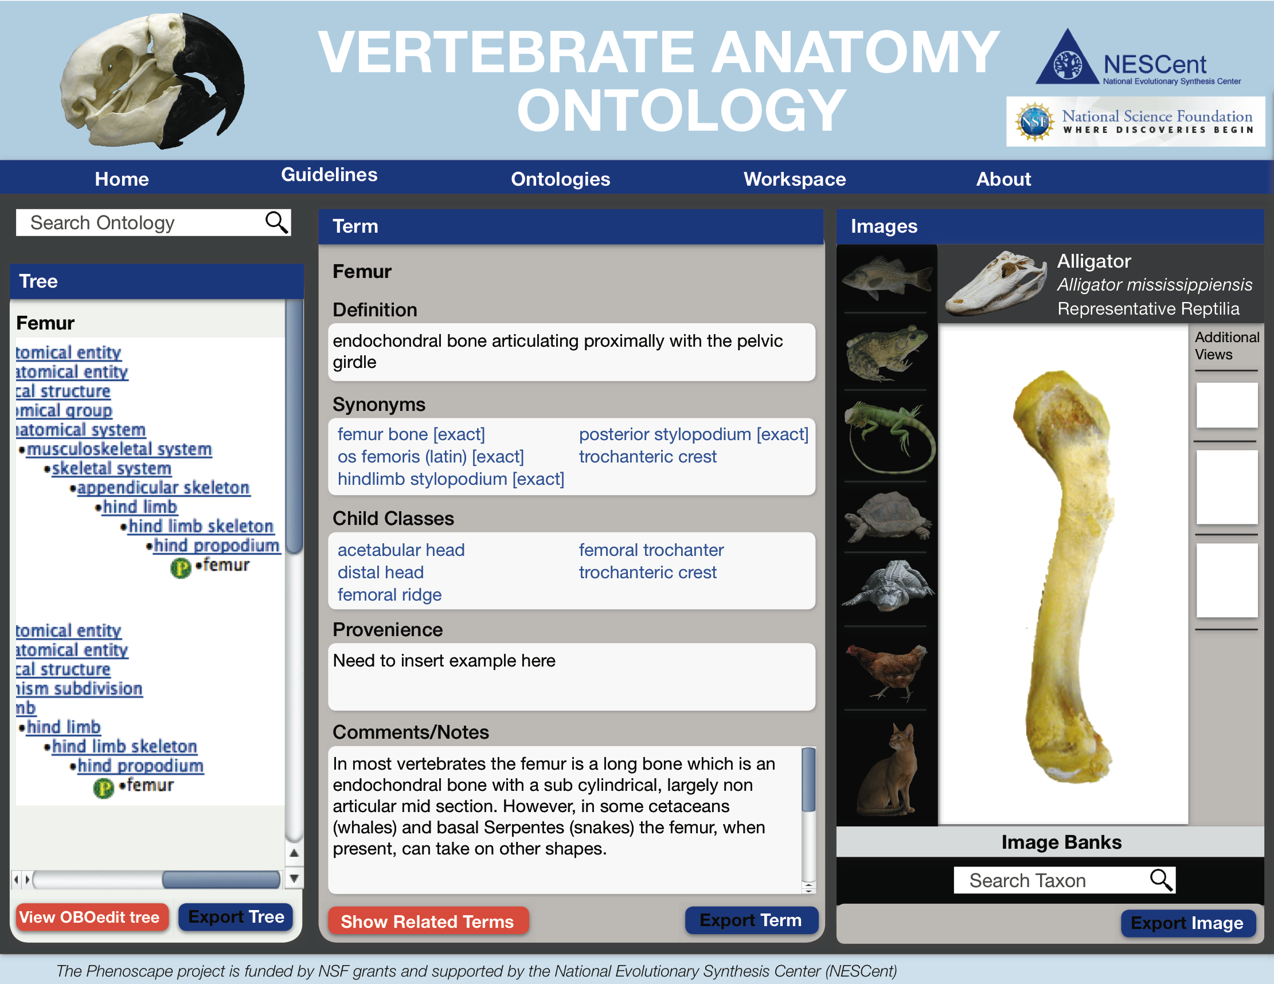

Slide 9
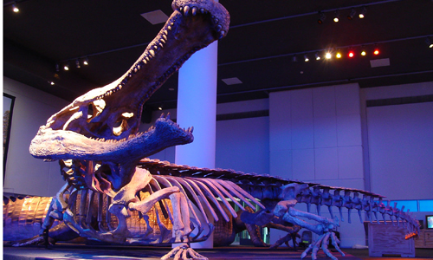

Slide 10
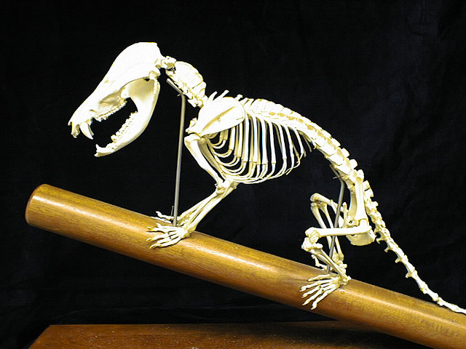

Slide 11
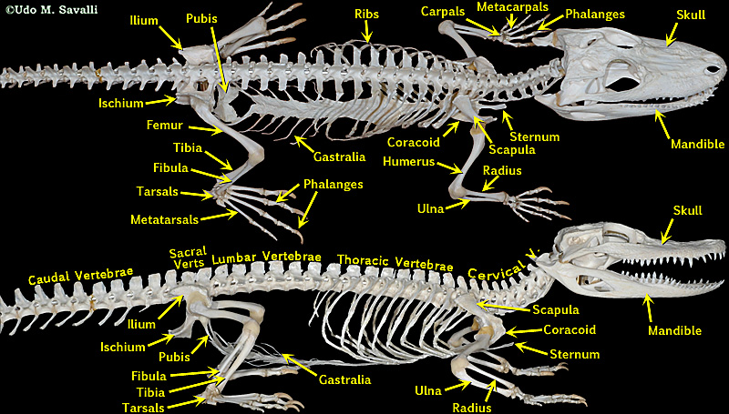

Slide 12
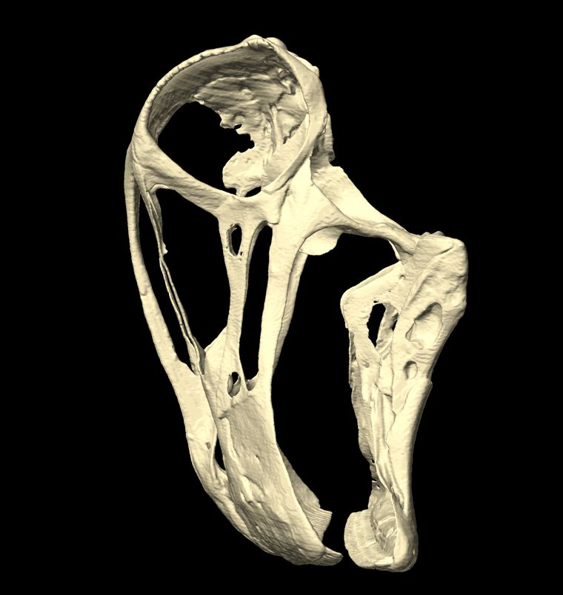

Slide 13
Other outreach
2 Native American students at USD with Mabee
Will work partly in association with Project Exploration
Participation in ‘Anatomy Ontologies’ course at NESCent (co-sponsored by Phenotype RCN) in July/August 2012

